Slide 1
CSC 2310 Object Oriented Programming & Design Chapter 5
Dr. Shah Alam

Slide 2
Static Methods
A static method is one that can be used without a calling object
A static method still belongs to a class, and its definition is given inside the class definition
When a static method is defined, the keyword static is placed in the method header
public static returnedType myMethod(parameters)
{ . . . }
Static methods are invoked using the class name in place of a calling object
returnedValue = MyClass.myMethod(arguments);

Slide 3
Pitfall: Invoking a Nonstatic Method Within a Static Method
A static method cannot refer to an instance variable of the class, and it cannot invoke a nonstatic method of the class
A static method has no this, so it cannot use an instance variable or method that has an implicit or explicit this for a calling object
A static method can invoke another static method, however

Slide 4
Static Variables
A static variable is a variable that belongs to the class as a whole, and not just to one object
There is only one copy of a static variable per class, unlike instance variables where each object has its own copy
All objects of the class can read and change a static variable
Although a static method cannot access an instance variable, a static method can access a static variable
A static variable is declared like an instance variable, with the addition of the modifier static
private static int myStaticVariable;

Slide 5
Static Variables
Static variables can be declared and initialized at the same time
private static int myStaticVariable = 0;
If not explicitly initialized, a static variable will be automatically initialized to a default value
boolean static variables are initialized to false
Other primitive types static variables are initialized to the zero of their type
Class type static variables are initialized to null
It is always preferable to explicitly initialize static variables rather than rely on the default initialization

Slide 6
Static Variables
A static variable should always be defined private, unless it is also a defined constant
The value of a static defined constant cannot be altered, therefore it is safe to make it public
In addition to static, the declaration for a static defined constant must include the modifier final, which indicates that its value cannot be changed
public static final int BIRTH_YEAR = 1954;
When referring to such a defined constant outside its class, use the name of its class in place of a calling object
int year = MyClass.BIRTH_YEAR;

Slide 7
Wrapper Classes
Wrapper classes provide a class type corresponding to each of the primitive types
This makes it possible to have class types that behave somewhat like primitive types
The wrapper classes for the primitive types byte, short, long, float, double, and char are (in order) Byte, Short, Long, Float, Double, and Character
Wrapper classes also contain a number of useful predefined constants and static methods

Slide 8
Wrapper Classes
Boxing: the process of going from a value of a primitive type to an object of its wrapper class
To convert a primitive value to an "equivalent" class type value, create an object of the corresponding wrapper class using the primitive value as an argument
The new object will contain an instance variable that stores a copy of the primitive value
Unlike most other classes, a wrapper class does not have a no-argument constructor
Integer integerObject = new Integer(42);

Slide 9
Wrapper Classes
Unboxing: the process of going from an object of a wrapper class to the corresponding value of a primitive type
The methods for converting an object from the wrapper classes Byte, Short, Integer, Long, Float, Double, and Character to their corresponding primitive type are (in order) byteValue, shortValue, intValue, longValue, floatValue, doubleValue, and charValue
None of these methods take an argument
int i = integerObject.intValue();

Slide 10
Automatic Boxing and Unboxing
Starting with version 5.0, Java can automatically do boxing and unboxing
Instead of creating a wrapper class object using the new operation (as shown before), it can be done as an automatic type cast:
Integer integerObject = 42;
Instead of having to invoke the appropriate method (such as intValue, doubleValue, charValue, etc.) in order to convert from an object of a wrapper class to a value of its associated primitive type, the primitive value can be recovered automatically
int i = integerObject;

Slide 11
Constants and Static Methods in Wrapper Classes
Wrapper classes have static methods that convert a correctly formed string representation of a number to the number of a given type
The methods Integer.parseInt, Long.parseLong, Float.parseFloat, and Double.parseDouble do this for the primitive types (in order) int, long, float, and double
Wrapper classes also have static methods that convert from a numeric value to a string representation of the value
For example, the expression
Double.toString(123.99);
returns the string value "123.99"
The Character class contains a number of static methods that are useful for string processing

Slide 12
References
Every variable is implemented as a location in computer memory
When the variable is a primitive type, the value of the variable is stored in the memory location assigned to the variable
Each primitive type always require the same amount of memory to store its values

Slide 13
References
When the variable is a class type, only the memory address (or reference) where its object is located is stored in the memory location assigned to the variable
The object named by the variable is stored in some other location in memory
Like primitives, the value of a class variable is a fixed size
Unlike primitives, the value of a class variable is a memory address or reference
The object, whose address is stored in the variable, can be of any size

Slide 14
Packages and Import Statements
Java uses packages to form libraries of classes
A package is a group of classes that have been placed in a directory or folder, and that can be used in any program that includes an import statement that names the package
The import statement must be located at the beginning of the program file: Only blank lines, comments, and package statements may precede it
The program can be in a different directory from the package

Slide 15
Import Statements
We have already used import statements to include some predefined packages in Java, such as Scanner from the java.util package
import java.util.Scanner;
It is possible to make all the classes in a package available instead of just one class:
import java.util.*;
Note that there is no additional overhead for importing the entire package

Slide 16
The package Statement
To make a package, group all the classes together into a single directory (folder), and add the following package statement to the beginning of each class file:
package package_name;
Only the .class files must be in the directory or folder, the .java files are optional
Only blank lines and comments may precede the package statement
If there are both import and package statements, the package statement must precede any import statements

Slide 17
The Package java.lang
The package java.lang contains the classes that are fundamental to Java programming
It is imported automatically, so no import statement is needed
Classes made available by java.lang include Math, String, and the wrapper classes

Slide 18
Package Names and Directories
A package name is the path name for the directory or subdirectories that contain the package classes
Java needs two things to find the directory for a package: the name of the package and the value of the CLASSPATH variable
The CLASSPATH environment variable is similar to the PATH variable, and is set in the same way for a given operating system
The CLASSPATH variable is set equal to the list of directories (including the current directory, ".") in which Java will look for packages on a particular computer
Java searches this list of directories in order, and uses the first directory on the list in which the package is found

Slide 19
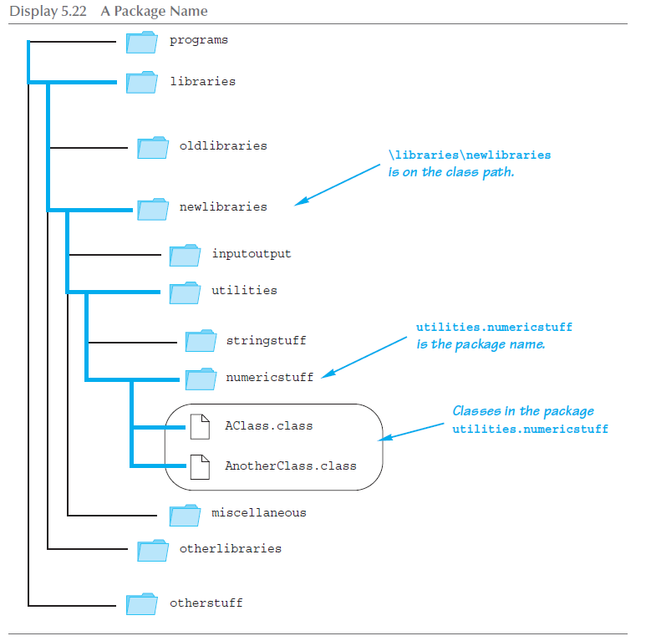
A Package Name

Slide 20
The following slides will not be included in any test.

Slide 21
Pitfall: Subdirectories Are Not Automatically Imported
When a package is stored in a subdirectory of the directory containing another package, importing the enclosing package does not import the subdirectory package
The import statement:
import utilities.numericstuff.*;
imports the utilities.numericstuff package only
The import statements:
import utilities.numericstuff.*;
import utilities.numericstuff.statistical.*;
import both the utilities.numericstuff and
utilities.numericstuff.statistical packages

Slide 22
Specifying a Class Path When You Compile
The class path can be manually specified when a class is compiled
Just add –classpath followed by the desired class path
This will compile the class, overriding any previous CLASSPATH setting
You should use the –classpath option again when the class is run

Slide 23
Name Clashes
In addition to keeping class libraries organized, packages provide a way to deal with name clashes: a situation in which two classes have the same name
Different programmers writing different packages may use the same name for one or more of their classes
This ambiguity can be resolved by using the fully qualified name (i.e., precede the class name by its package name) to distinguish between each class
package_name.ClassName
If the fully qualified name is used, it is no longer necessary to import the class (because it includes the package name already)

Slide 24
Introduction to javadoc
Unlike a language such as C++, Java places both the interface and the implementation of a class in the same file
However, Java has a program called javadoc that automatically extracts the interface from a class definition and produces documentation
This information is presented in HTML format, and can be viewed with a Web browser
If a class is correctly commented, a programmer need only refer to this API (Application Programming Interface) documentation in order to use the class
javadoc can obtain documentation for anything from a single class to an entire package

Slide 25
Commenting Classes for javadoc
The javadoc program extracts class headings, the headings for some comments, and headings for all public methods, instance variables, and static variables
In the normal default mode, no method bodies or private items are extracted
To extract a comment, the following must be true:
The comment must immediately precede a public class or method definition, or some other public item
The comment must be a block comment, and the opening /* must contain an extra * ( /** . . . */ )
Note: Extra options would have to be set in order to extract line comments ( // ) and private items

Slide 26
Commenting Classes for javadoc
In addition to any general information, the comment preceding a public method definition should include descriptions of parameters, any value returned, and any exceptions that might be thrown
This type of information is preceded by the @ symbol and is called an @ tag
@ tags come after any general comment, and each one is on a line by itself
/**
General Comments about the method . . .
@param aParameter Description of aParameter
@return What is returned
. . .
*/

Slide 27
@ Tags
@ tags should be placed in the order found below
If there are multiple parameters, each should have its own @param on a separate line, and each should be listed according to its left-to-right order on the parameter list
If there are multiple authors, each should have its own @author on a separate line
@param Parameter_Name Parameter_Description
@return Description_Of_Value_Returned
@throws Exception_Type Explanation
@deprecated
@see Package_Name.Class_Name
@author Author
@version Version_Information

Slide 28
Running javadoc
To run javadoc on a package, give the following command:
javadoc –d Documentation_Directory Package_Name
The HTML documents produced will be placed in the Documentation_Directory
If the –d and Documentation_Directory are omitted, javadoc will create suitable directories for the documentation
To run javadoc on a single class, give the following command from the directory containing the class file: javadoc ClassName.java
To run javadoc on all the classes in a directory, give the following command instead: javadoc *.java

Slide 29
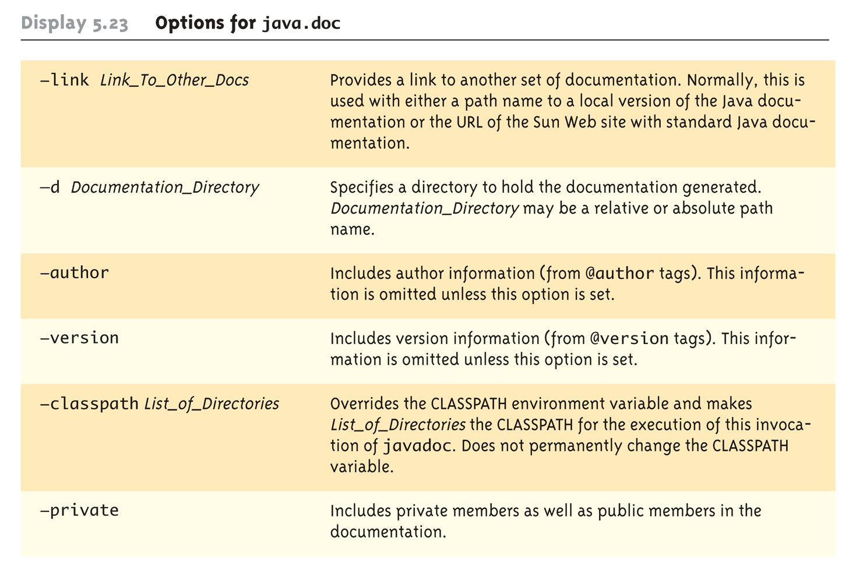
Options for javadoc

Slide 30
The Math Class
The Math class provides a number of standard mathematical methods
It is found in the java.lang package, so it does not require an import statement
All of its methods and data are static, therefore they are invoked with the class name Math instead of a calling object
The Math class has two predefined constants, E (e, the base of the natural logarithm system) and PI (π, 3.1415 . . .)
area = Math.PI * radius * radius;

Slide 31
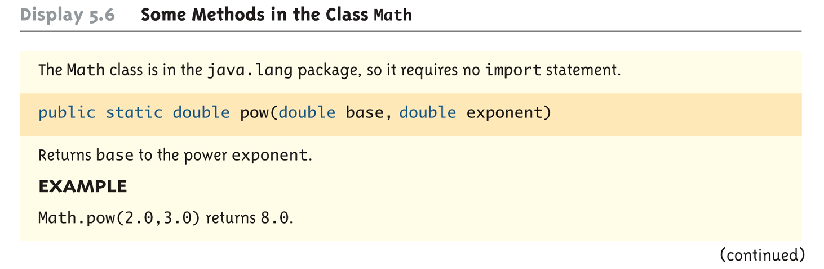
Some Methods in the Class Math (Part 1 of 5)

Slide 32
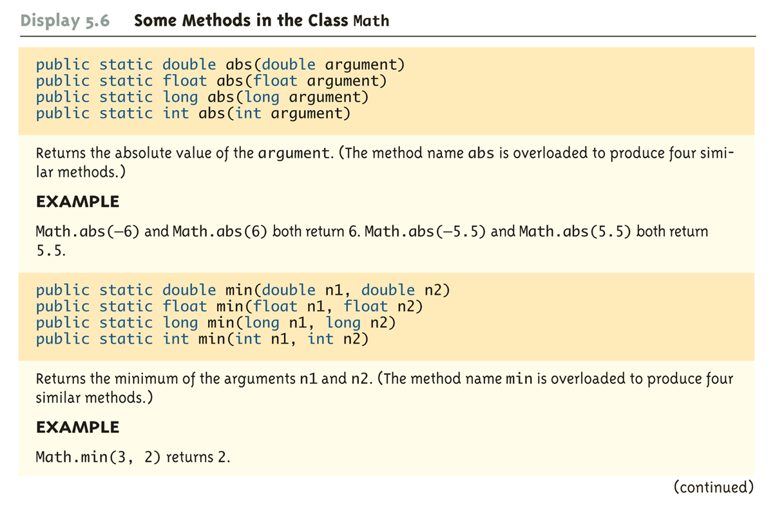
Some Methods in the Class Math (Part 2 of 5)

Slide 33
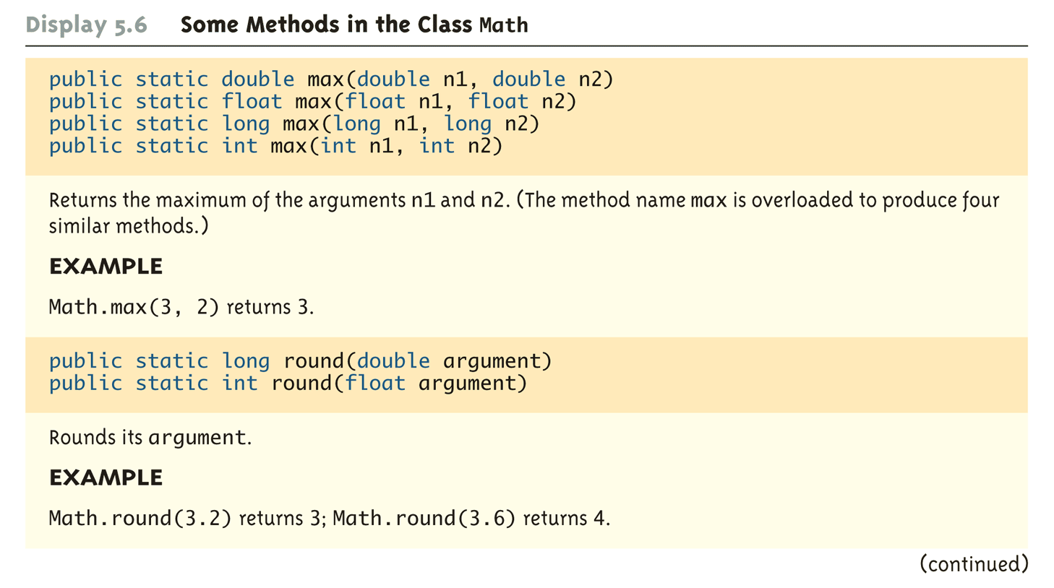
Some Methods in the Class Math (Part 3 of 5)

Slide 34
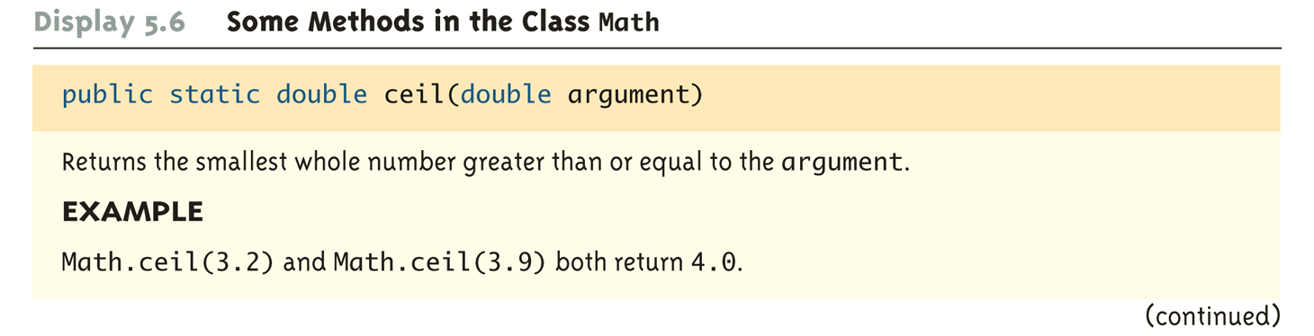
Some Methods in the Class Math (Part 4 of 5)

Slide 35
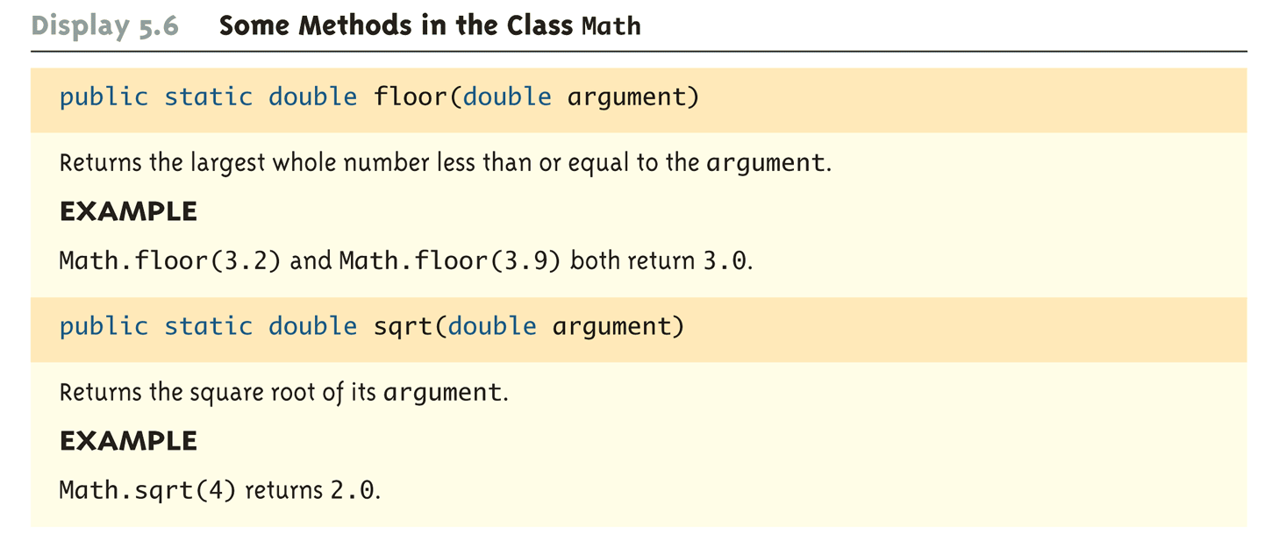
Some Methods in the Class Math (Part 5 of 5)

Slide 36
Random Numbers
The Math class also provides a facility to generate pseudo-random numbers
A pseudo-random number appears random but is really generated by a deterministic function
There is also a more flexible class named Random
Sample use:
Returns a pseudo-random number greater than or equal to 0.0 and less than 1.0
public static double random()
double num = Math.random();

